Slide 1
Final Talk: An EMG-based Method For Finger Gesture Recognition 10.04.2018
Advisors: Marko Jovanovic, Stephan Jonas Department of Medical Informatics, Uniklinik RWTH Aachen

Slide 2
Outline
Motivation
State of the art
Data
Pipeline
Results
Discussion
Conclusion

Slide 3

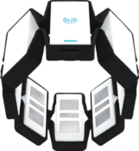
Motivation
MediWeCo: Contribution to learning and teaching physiotherapy through feedback.
Classify finger movements from EMGs.
Control virtual objects with finger movements.
Interpretation of sign language.
Notes:
- Contribute to MediWeCo project in order to refine the detection of the little finger movements in order to give constructive feedback to teaching and learning of physiotherapeutic skills.
- Classify finger movements from EMGs acquired with Myo with a neural network.
- Practical not only for sign language communication but also for military communication where sound based communication is not appropriate.

Slide 4
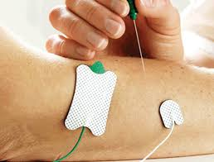
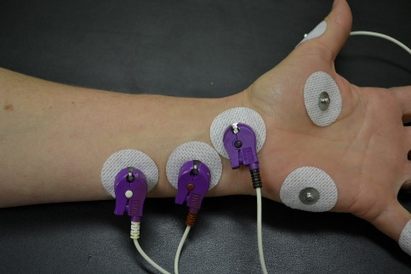
Why electromyography?
Notes:
With Electromyography we can measure the electrical activity of the muscles:
There are two kinds of EMG electrodes:
Surface EMG electrodes where is placed on the skin with adhesive, over the muscle of interest.
+Relatively cheap, noninvasive, and have a large pickup area
-Lot of crosstalk
Intramuscular EMG sensors
+Record focally from deep muscles +reduction of crosstalk
-Painful for patients and far from everyday applications

Slide 5
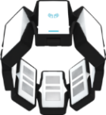
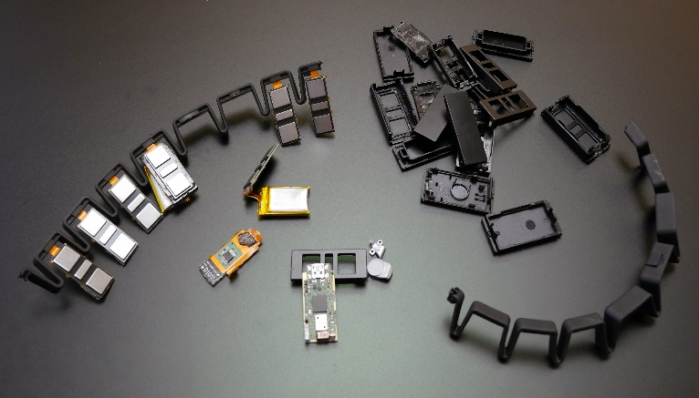
Thalmic Myo
Why Myo?
Safe, easy, cheap, non-invasive
No gel to facilitate conductivity
Wireless
Technical Characteristics
3-axis gyroscope
3-axis accelerometer
3-axis magnetometer
8 EMG sensors
Notes:
Myo has: 8 EMG electrodes and in each cubbie there is a small circuit board, and there are two batteries tucked in different cubbies. The Myo is composed of 8 EMG surface dry sensors. These sensors measure the electrical activity of the muscles of the forearm at a sampling rate of 200 Hz with 8 bits of resolution for each sensor. The forearm muscles are responsible for the movements of the different parts of the hand. The Myo transmits its measurements to the computer via Bluetooth. Additionally, the Myo contains an inertial measurement unit (IMU) with 9 degrees of freedom (accelerometer, gyroscope, and orientation in the x, y, and z axes). Finally, the Myo comes with a proprietary system for recognizing 5 gestures of the hand: pinch, fist, open, wave in, and wave out.

Slide 6
Goal: finger gesture recognition with Myo
For different finger gestures find best detection accuracy
Signals acquired with Myo
Work solely with EMG signals
Notes:
Determine the best combination of features -> best detection accuracy among the different finger gestures.
Due to the fact that for the experiments finger gestures will be examined, (NO ARM MOTION) the arm of the subject will not be moved, will remain still, so no IMU data will be needed. So, I will focus only on acquiring EMG signals from Myo.

Slide 7
Outline
Motivation
State of the art
Data
Pipeline
Results
Discussion
Conclusion

Slide 8
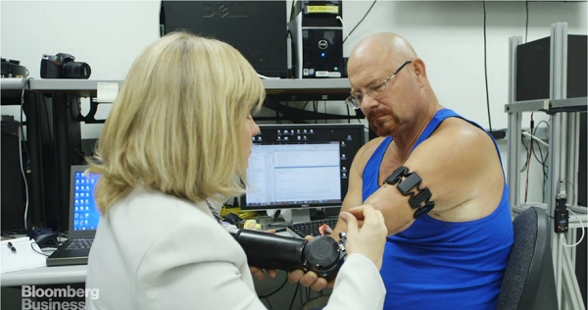
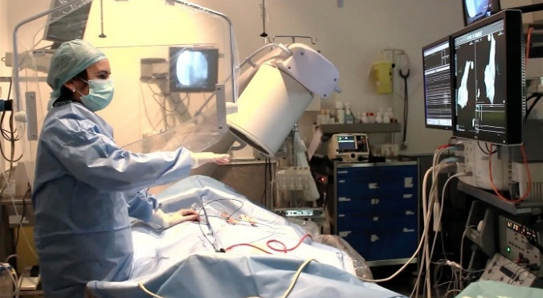
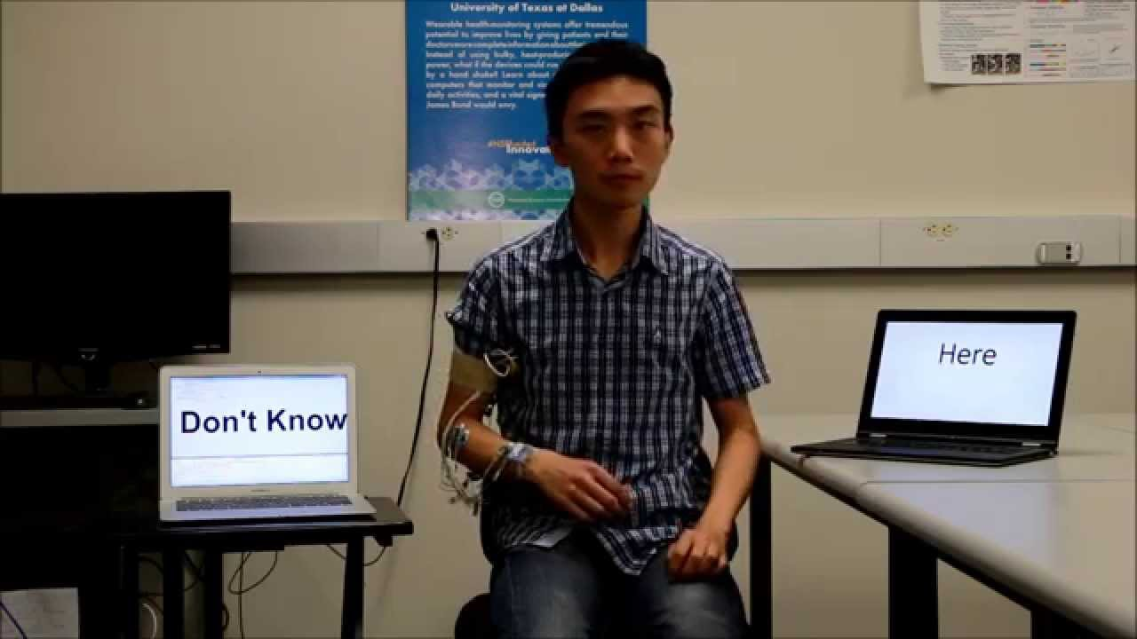
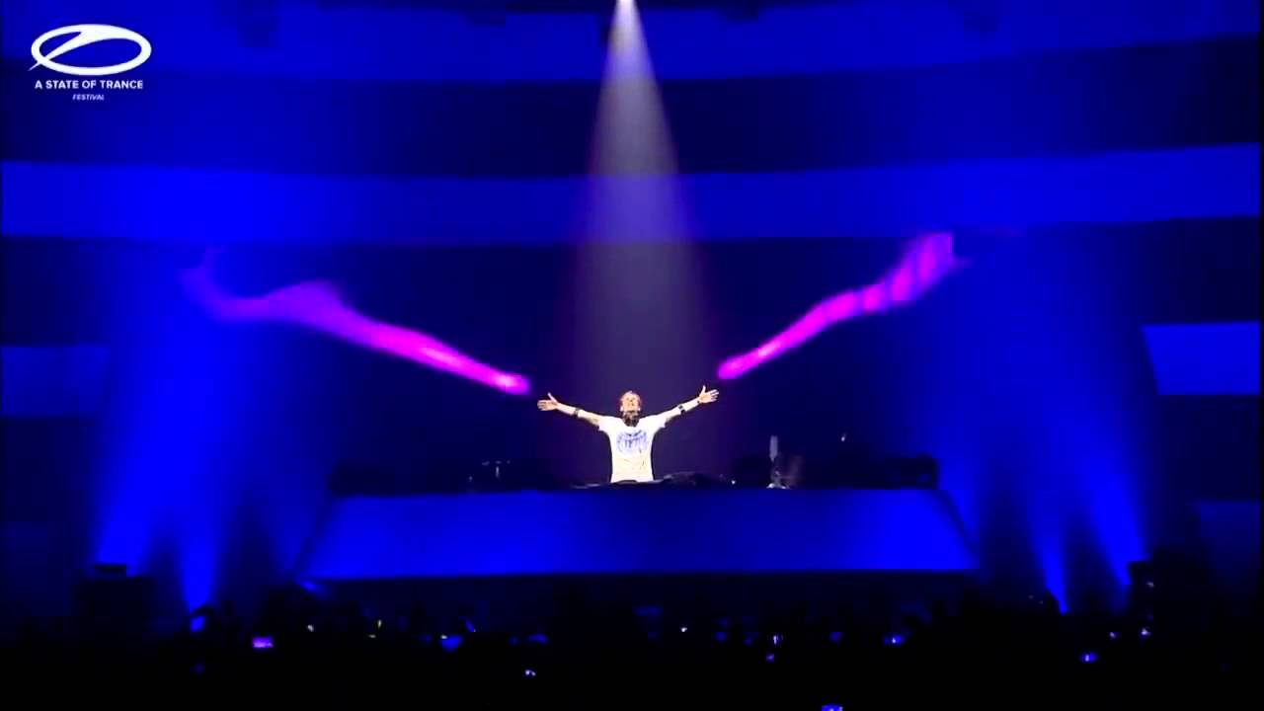
State of the art
Robotic arm control
Surgery interface control
Sign lagnuage recognition
Control of stage effects
Notes:
-There is a prosthetic arm attached directly to his skeleton, and uses two Myo armbands on his upper arm to detect the electrical activity of his muscles. When he thinks about moving his prosthetic hand, he is able to do it. To start using his robotic arms Baugh had to undergo surgery at Johns Hopkins Hospital known as targeted muscle reinnervation. Revolutionizing Prosthetics Program, is almost at decade long project to create a neurally controlled artificial limbs to amputee patients is funded by the Defense Advanced Research Projects Agency (DARPA).
-A medical imaging firm from Spain called TedCas they used Myo armband, various cameras, and voice recognition software to give surgeons total control over the information they need during an operation: it’s a multi-sensor solution for operating rooms all connected to a device called the “TedCube”. So Myo can be used by surgeons in Spain to navigate through medical records while in the middle of surgery.
A group of students from the University of Texas at Dallas they achieved real-time American Sign Language Recognition using Wrist-worn Motion and Surface EMG sensors.
To do the recognition, we created an automatic adaptive segmentation technique to determine the period when a gesture is performed. 76 features from sEMG signal and 192 features from inertial sensors are studied and the best subset features are selected based on a feature ranking algorithm. Four different classification algorithms are evaluated, which are Decision Tree, Nearest Neighbor, Naïve Bayes and Support Vector Machine.
-Armin van Buuren controlled the stage effects during his performance such as control stage lights in real time with his hands

Slide 9
Outline
Motivation
State of the art
Data
Pipeline
Results
Discussion
Conclusion

Slide 10
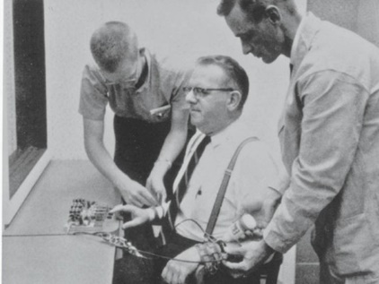
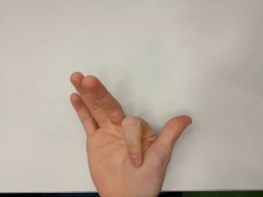
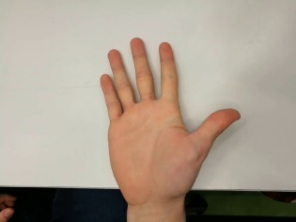
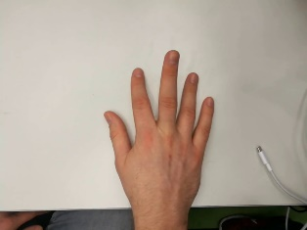
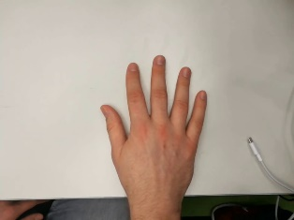
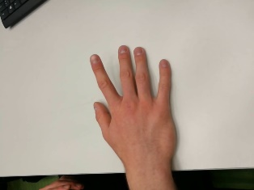
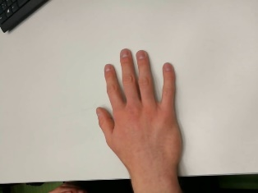
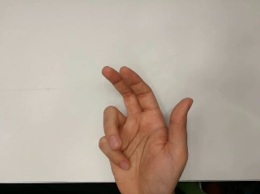
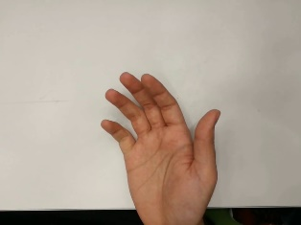
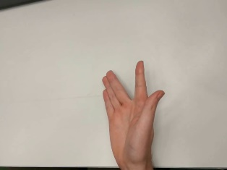
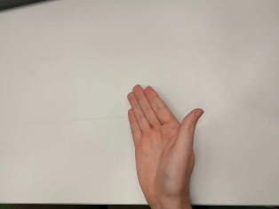
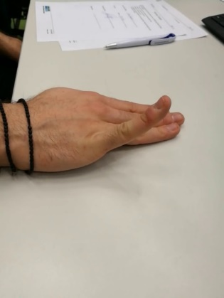
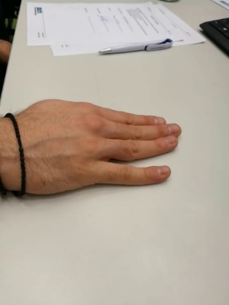
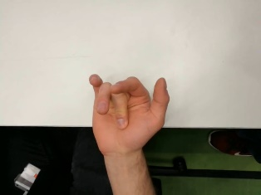
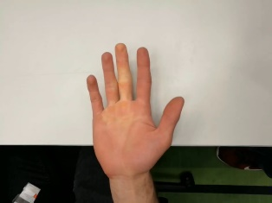
Finger gestures
N=21
Flexions
Extensions
Flexions
Extensions
G1
G5
G2
G6
G3
G4
G7

Slide 11
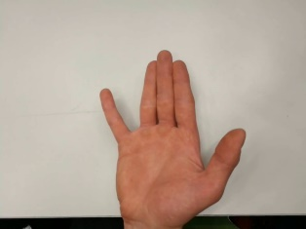
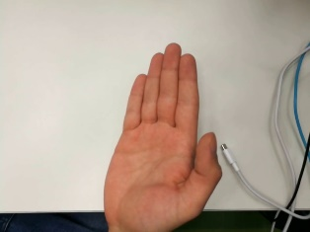
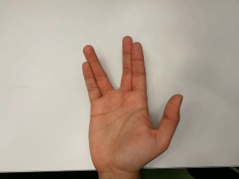
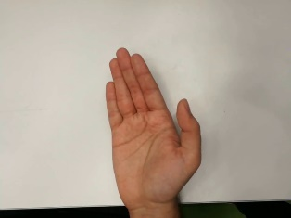
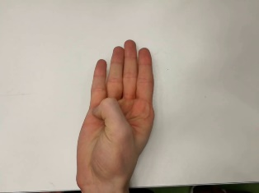
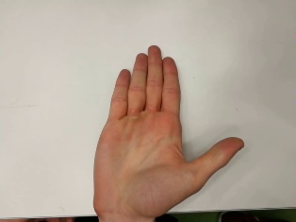
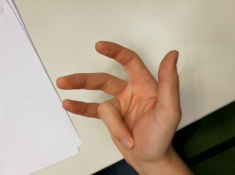
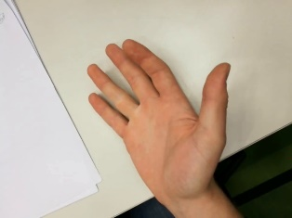
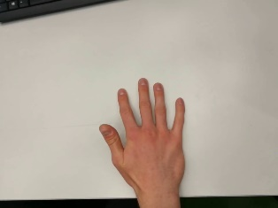
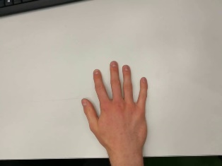
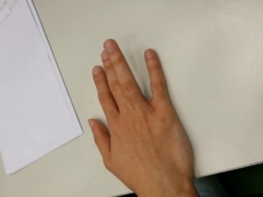
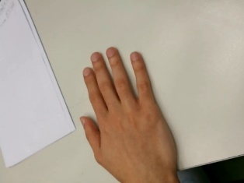
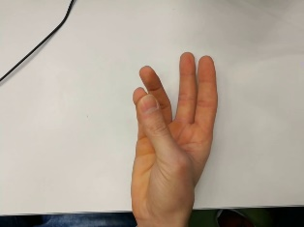
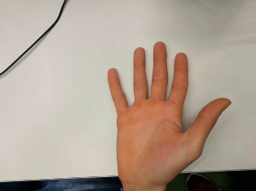
Finger gestures cont‘d
Flexion
Extension
Flexion
Extension
G8
G12
G9
G13
G10
G14
G11

Slide 12
Outline
Motivation
State of the art
Data
Pipeline
Results
Discussion
Conclusion

Slide 13
Pipeline overview
+Video
EMG acquisition with Myo
Artifacts removal
Individual movements segmentation
Data division into 11 folds
Windowing
Feature extraction
Classification
Detection accuracies
Notes:
Here we see the different steps to preprocess the data through different methods and import them in the classifier for classification.

Slide 14
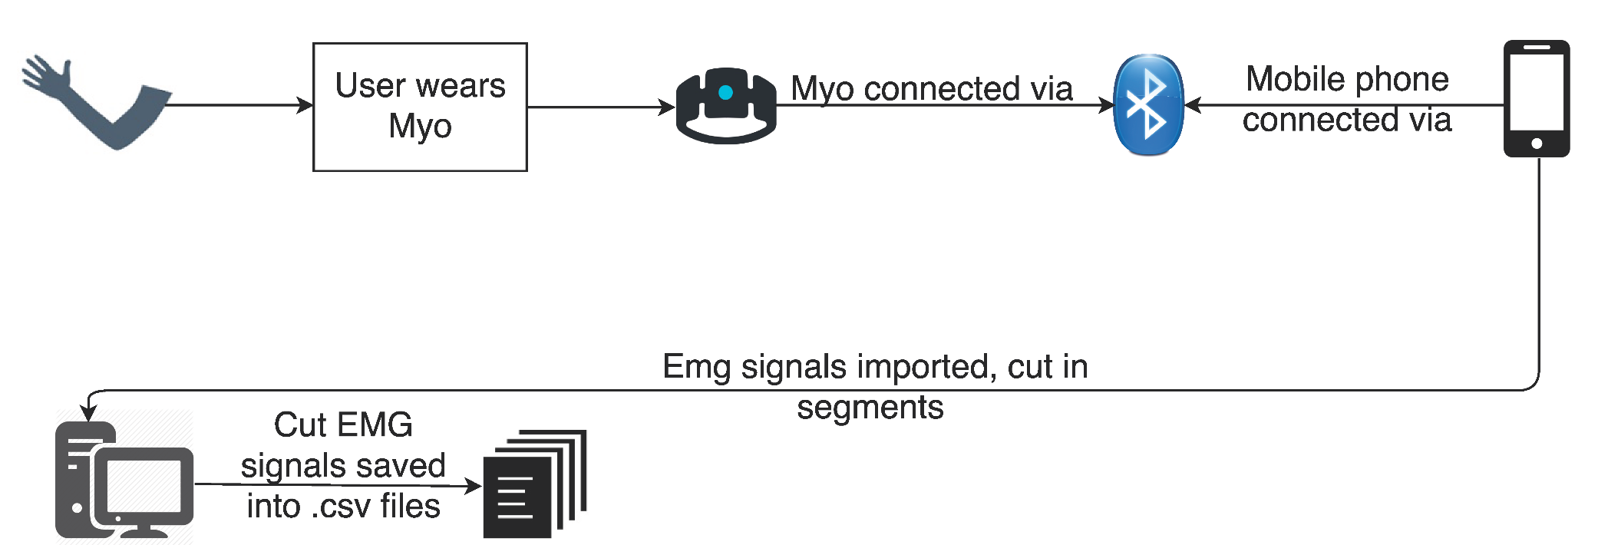
Data collection

Slide 15
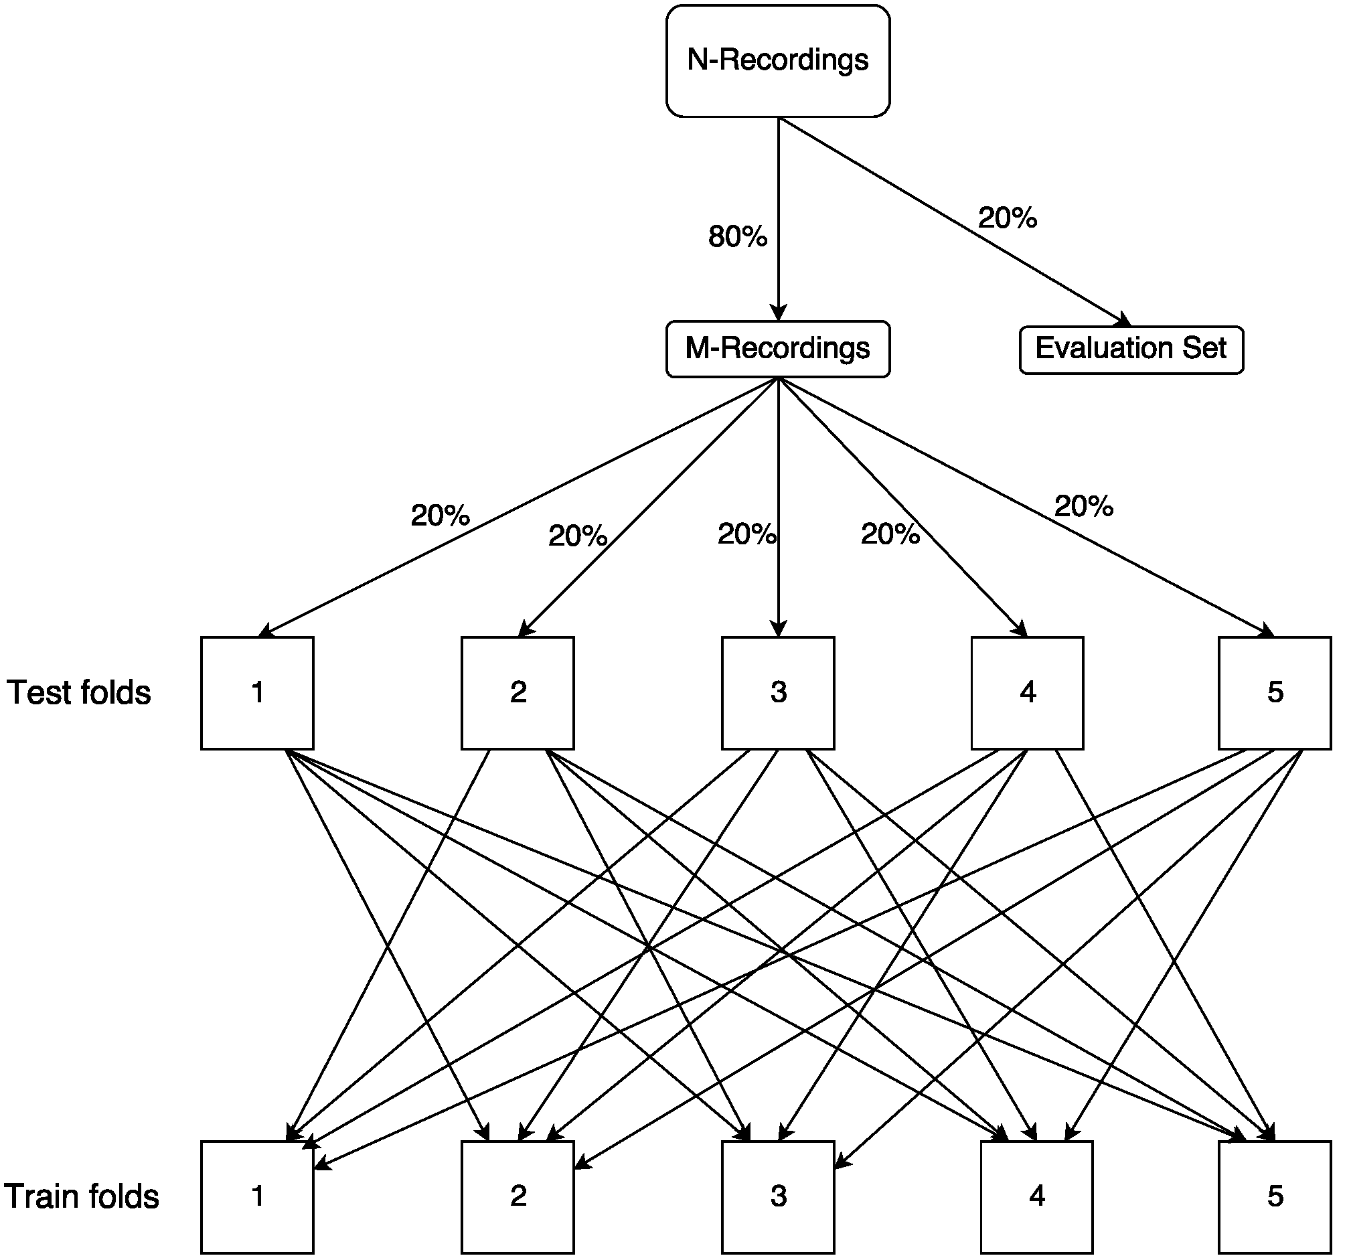
Data division

Slide 16
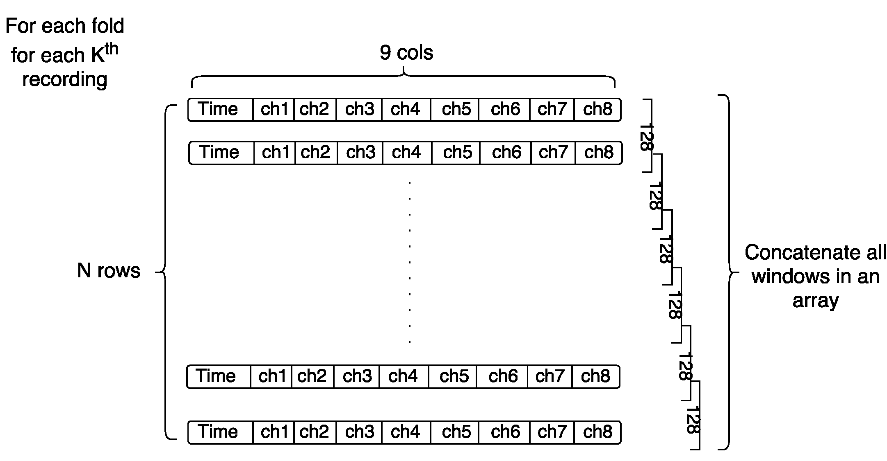
Windowing

Slide 17
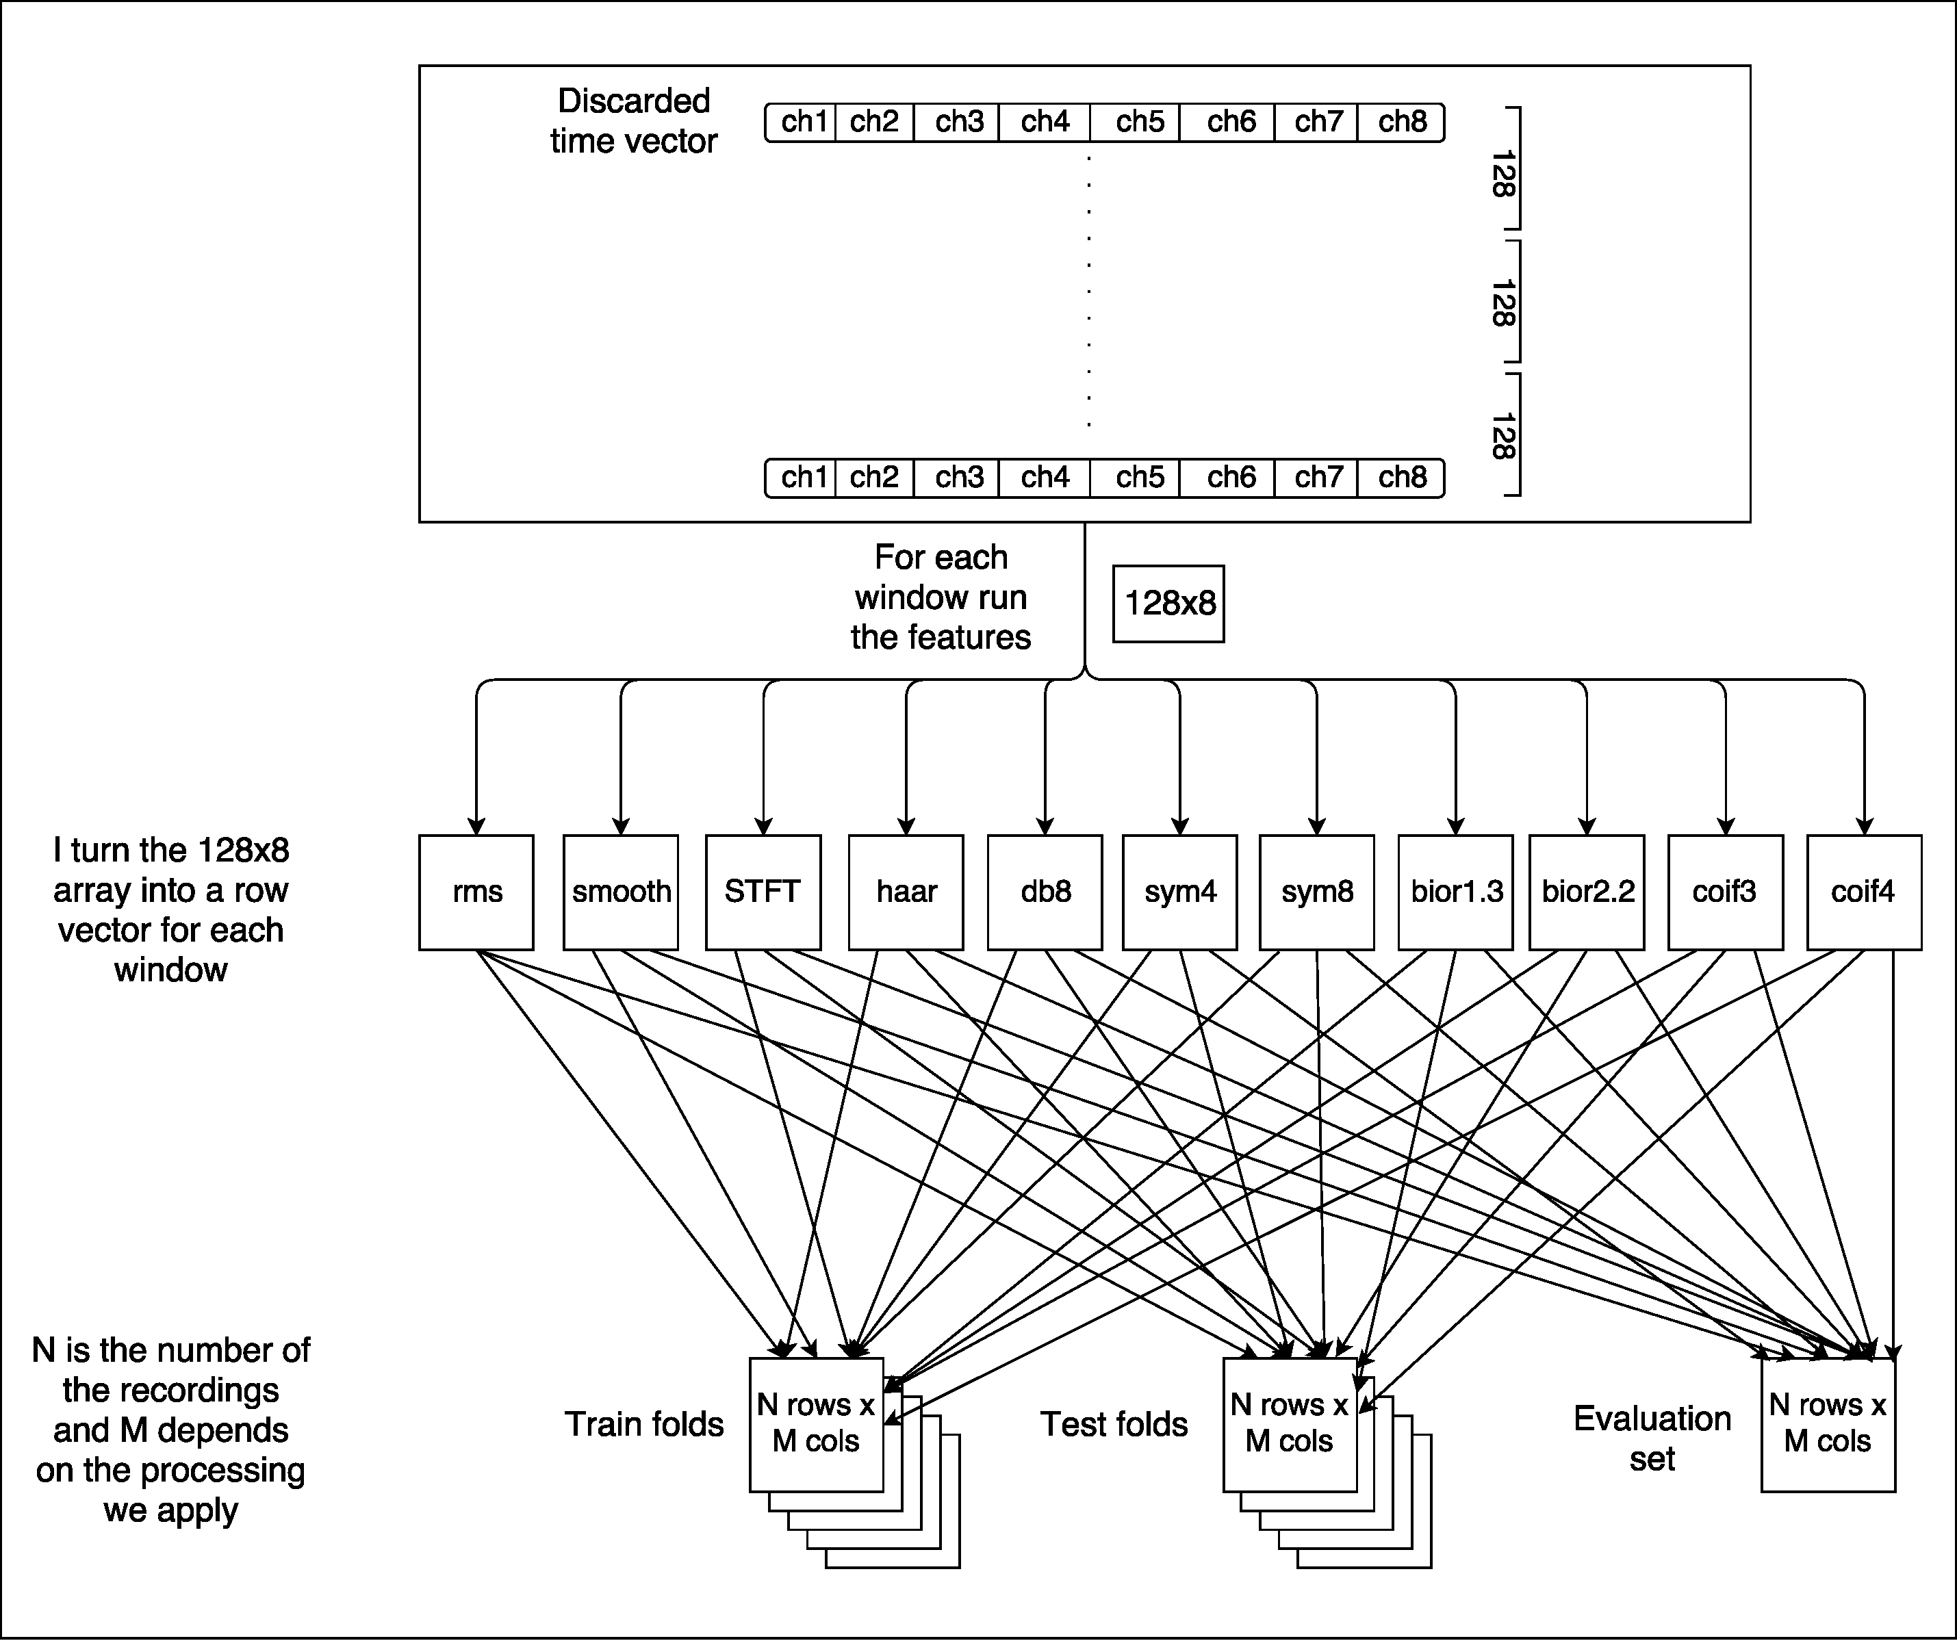
Feature extraction

Slide 18
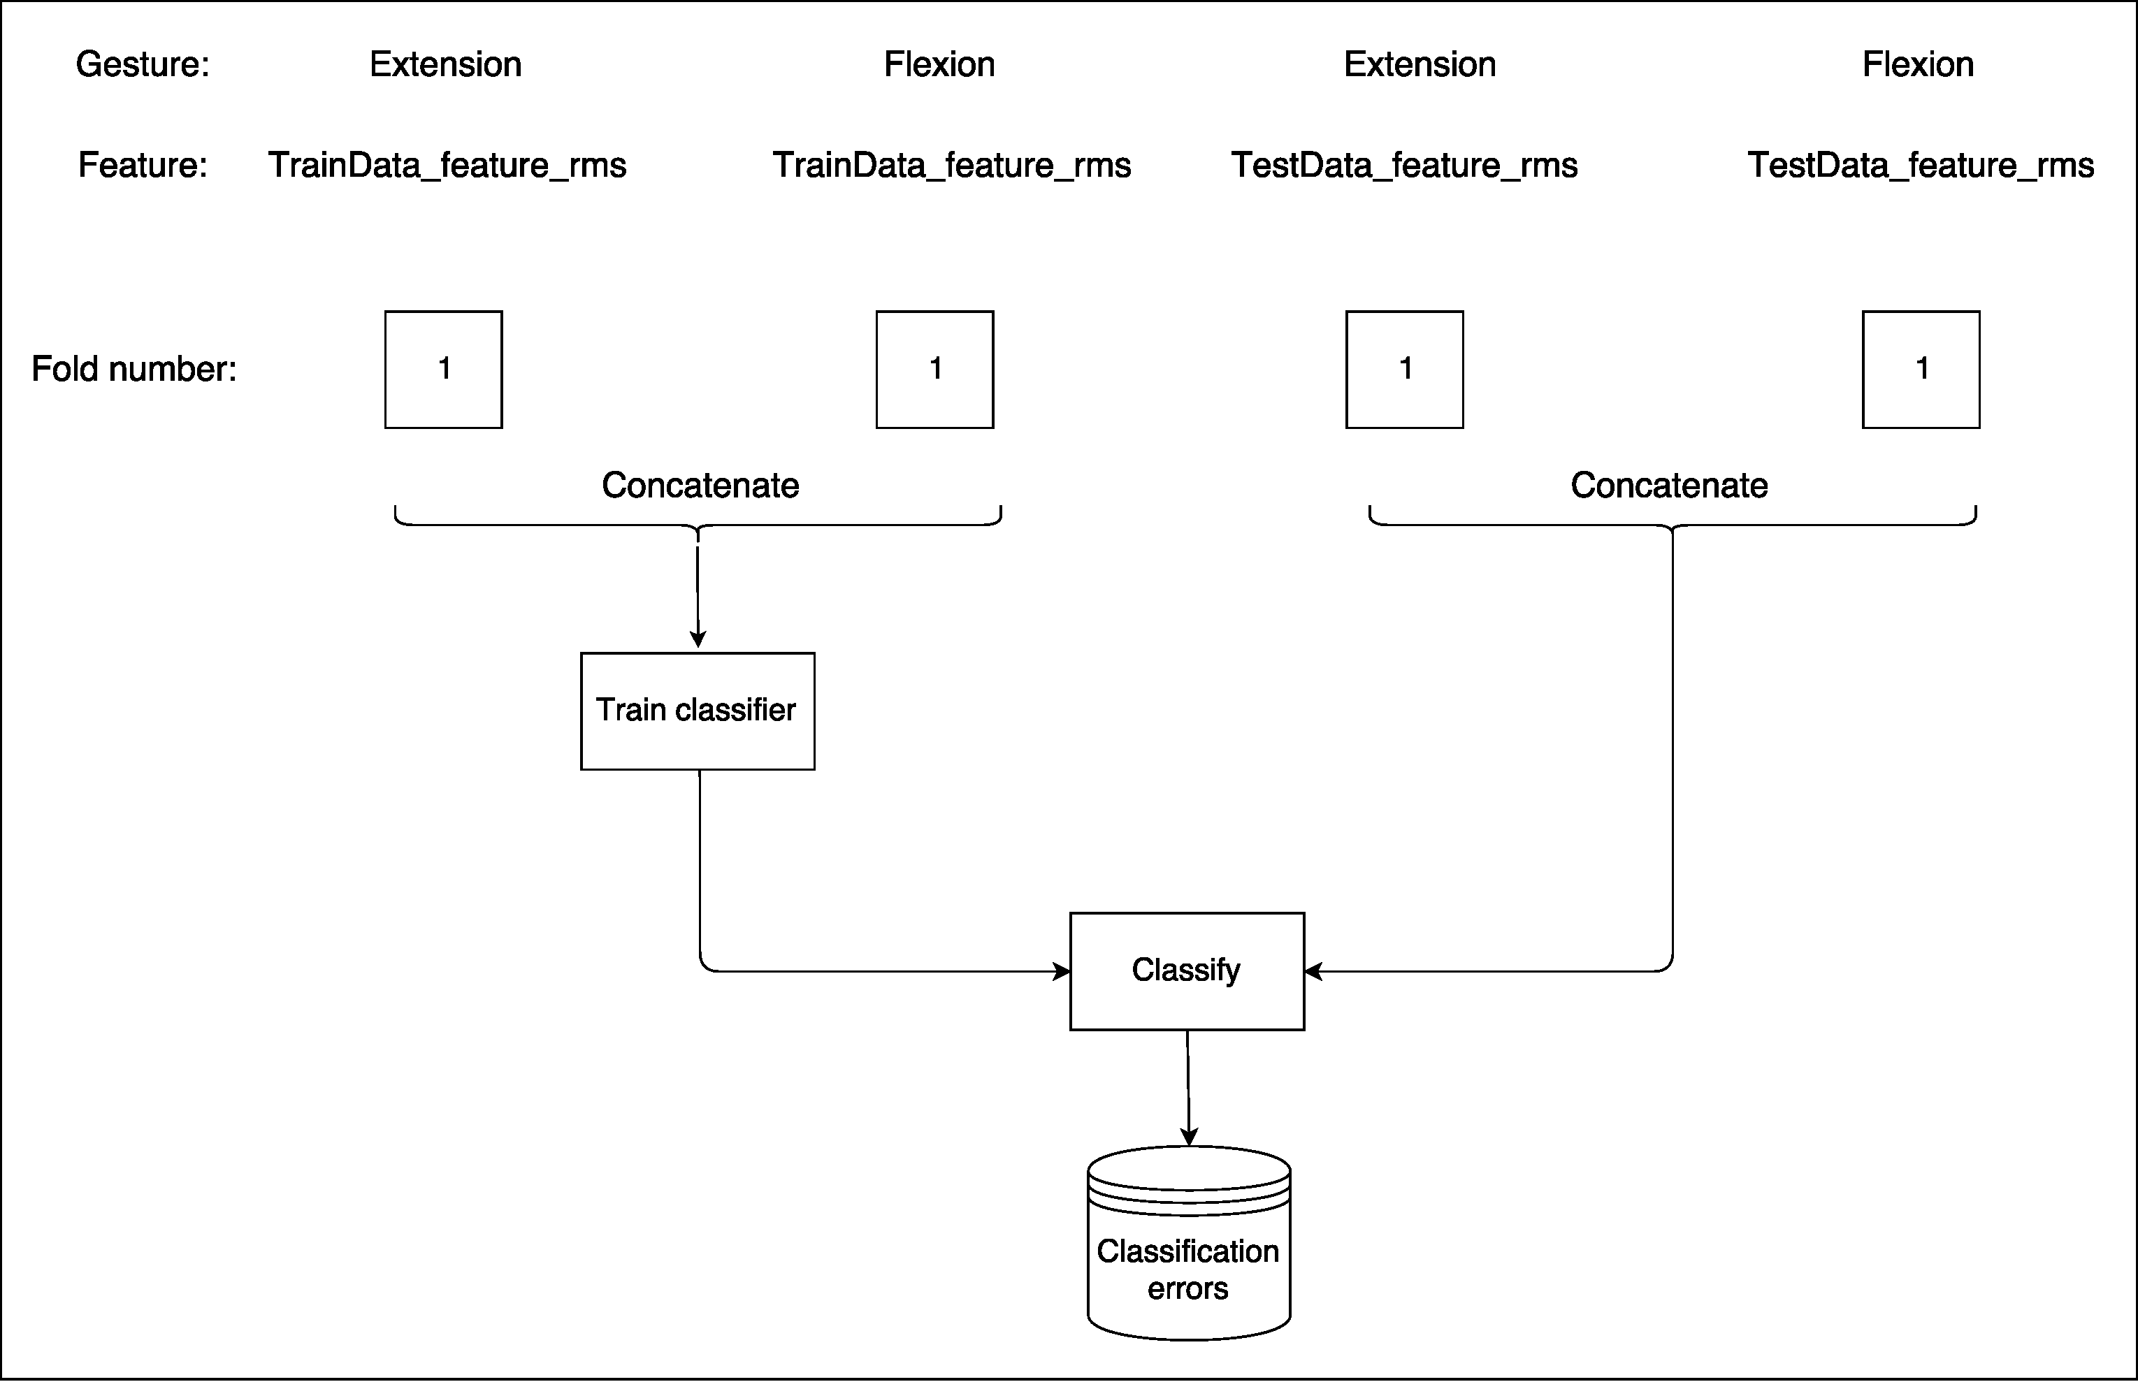
Train & classification

Slide 19
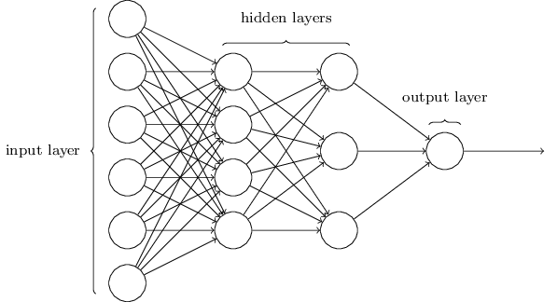
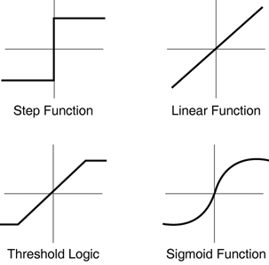
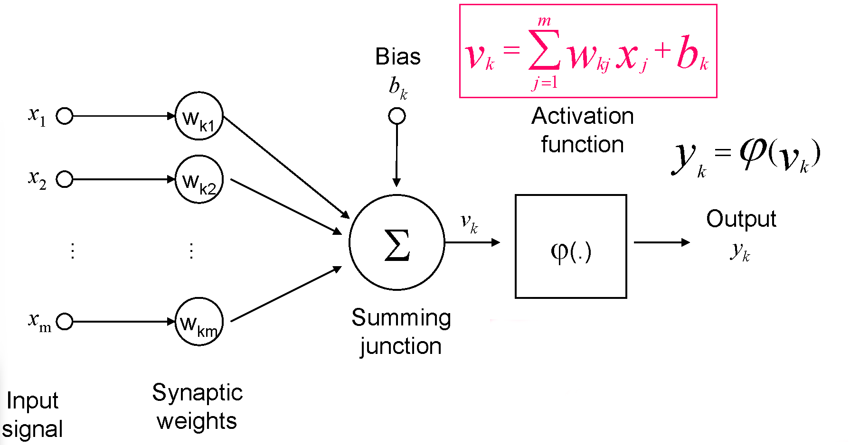
Multilayer Perceptron
Notes:
“Sequential” learning means that a given input pattern is forward propagated, the error is determined and back-propagated, and the weights are updated.
Then the same procedure is repeated for the next pattern.

Slide 20
Outline
Motivation
State of the art
Data
Pipeline
Results
Discussion
Conclusion

Slide 21
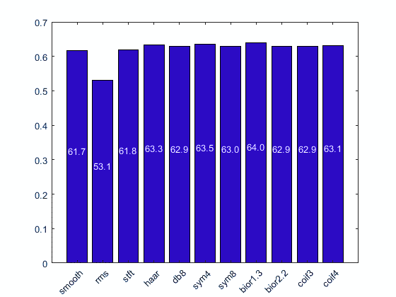
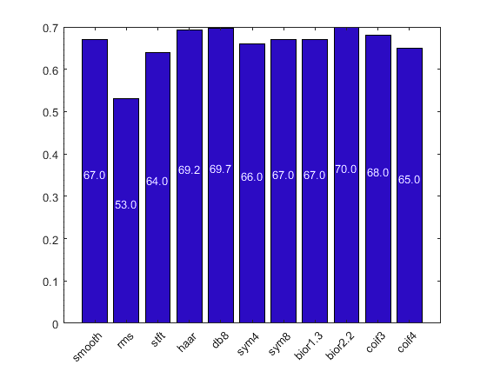

Results
Notes:
Results from NN with HL=1 and HN=5
with step 1, step 64 and one feature per training
We started using a dataset which consisted of extensions and flexions of my thumb. We used a neural network with 1 hidden layer and 5 hidden neurons. During the windowing, the stage before the feature extraction we used a step of one. And we got these detection accuracies. Because of the big load of data the runtime was very considerably long. So we decided to increase the step of windowing from 1 to 64. So we saw that the detection accuracies increased while the runtime was decreased.

Slide 22
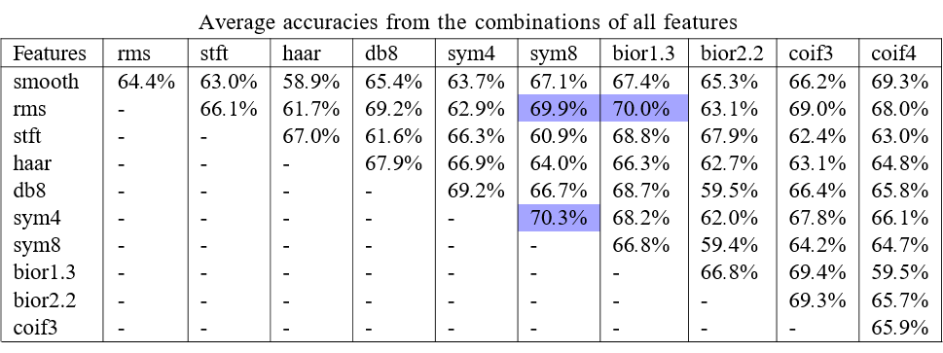
Results
Notes:
The average detection accuracies of 5NNs
with two features per training

Slide 23
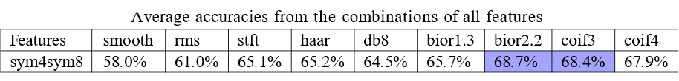


Results
Notes:
with three features per training

Slide 24

Results

Slide 25

Evaluation data
Gesture | db8 | bior2.2 | coif3
G9 | 73.5 | 73.5 | 74.3

Slide 26
Outline
Motivation
State of the art
Data
Pipeline
Results
Discussion
Conclusion

Slide 27
Discussion
Fluctuation of detection accuracies for different number of layers.
Data quality.

Slide 28
Outline
Motivation
State of the art
Data
Pipeline
Results
Discussion
Conclusion

Slide 29
Conclusions & Further work
Extract more features.
Rectification and normalization of the data in order to apply methods to reduce the final size of the input vector.
Test with different neural network architectures such as convolutional, recurrent neural networks.

